Slide 1


INTRODUCTION TO
QUANTUM COMPUTING

Slide 2
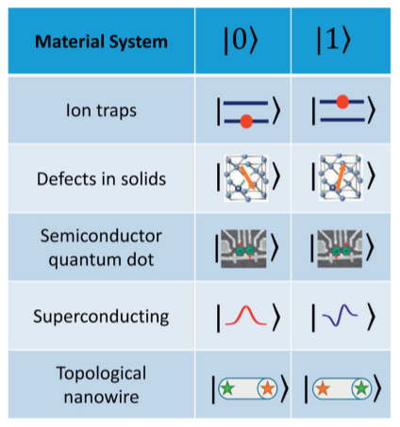
WHAT IS
QUANTUM COMPUTING?
Quantum computing is a new type of computing that uses the rules of quantum mechanics to handle information very differently from traditional computers.
Traditional computers use bits as their basic data units, which are either 0 or 1. However, quantum computers use quantum bits, or qubits. These qubits can be both 0 and 1 at the same time because of a property called superposition.

Slide 3
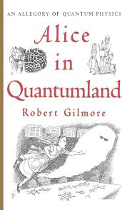
Some Properties of quantum mechanics
Imagine stepping into a world like "Alice in Wonderland," where things don't always work the way you expect them to.
Quantum Tunneling
Heisenberg's Uncertainty Principle
Superposition
Quantum Entanglement
Wave-Particle Duality

Slide 4



Key Quantum Properties in quantum Computing
Superposition
Quantum Entanglement
Measurement
quantum system can exist in multiple states at once. In quantum computing, qubits can be both 0 and 1 simultaneously, allowing quantum computers to process complex calculations much faster than classical computers by exploring multiple possibilities at the same time.
It's a phenomenon where pairs or groups of particles become linked in such a way that the state of one particle instantly influences the state of another, no matter how far apart they are.
Quantum states (like the superpositions of qubits) are not definite until they are measured. Once a quantum system is measured, it collapses to one of the possible configurations.

Slide 5

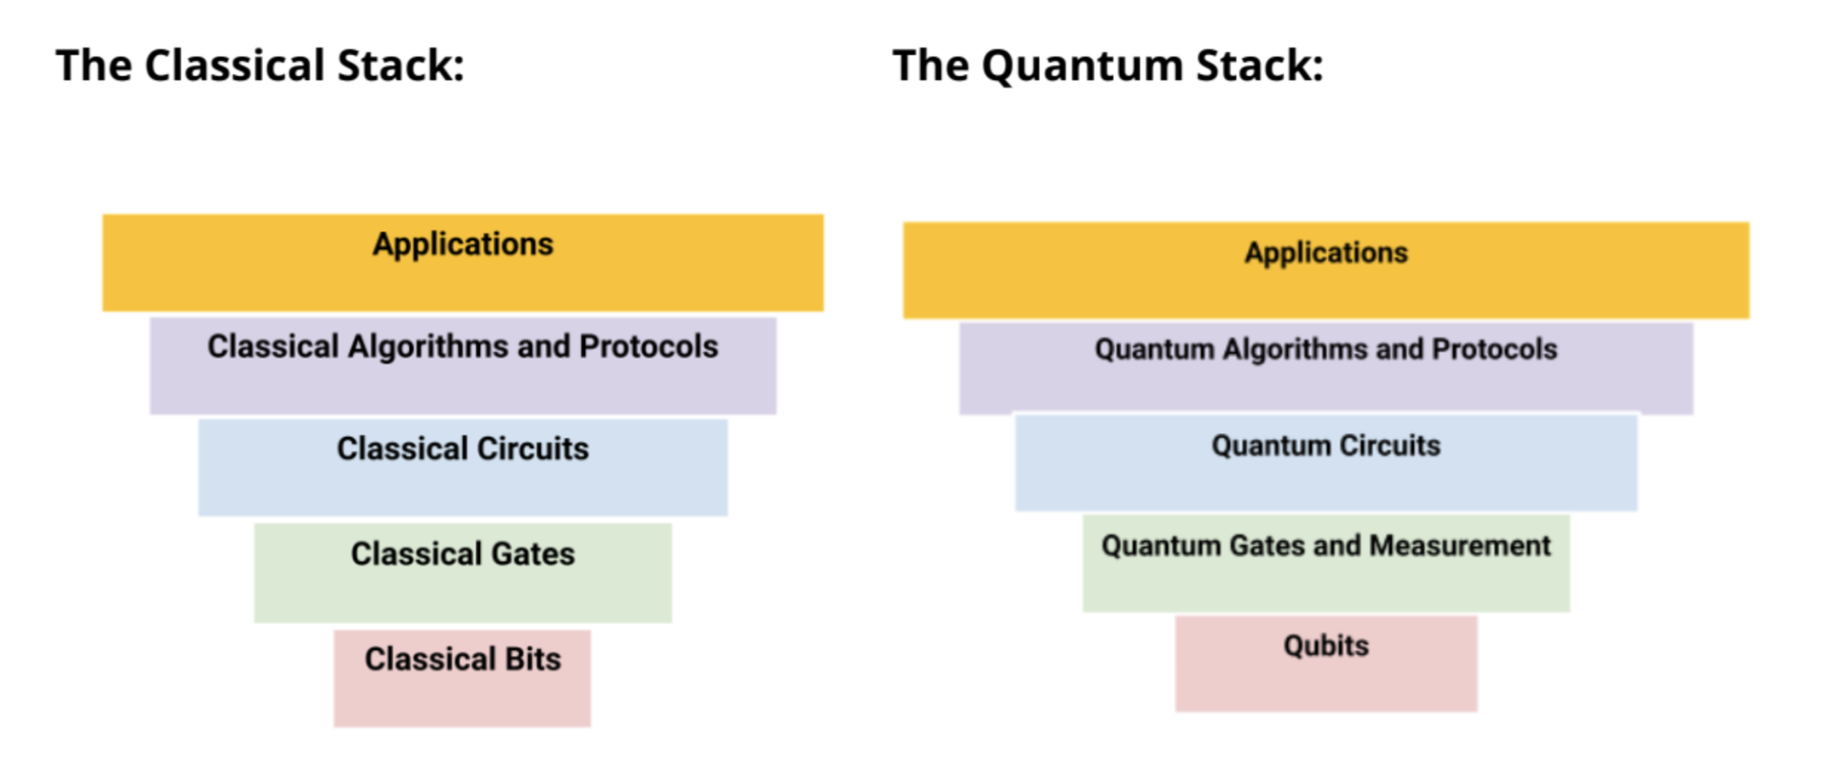
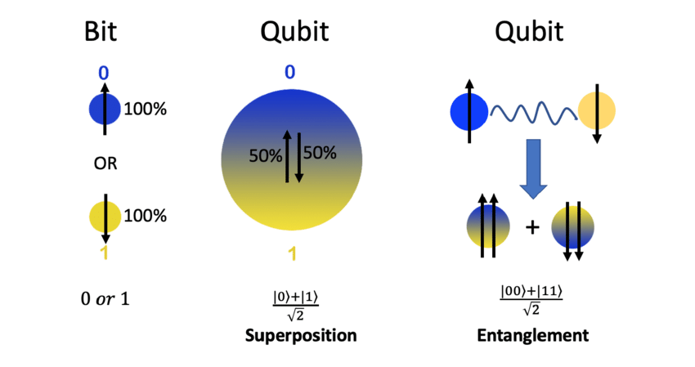
Qubits:
The foundational layer of the Quantum Stack, qubits are the basic units of quantum information, analogous to bits in classical computing. Unlike classical bits, which are either 0 or 1, qubits can exist in superpositions of both states simultaneously, and this property is fundamental to the increased computational power of quantum computers.

Slide 6
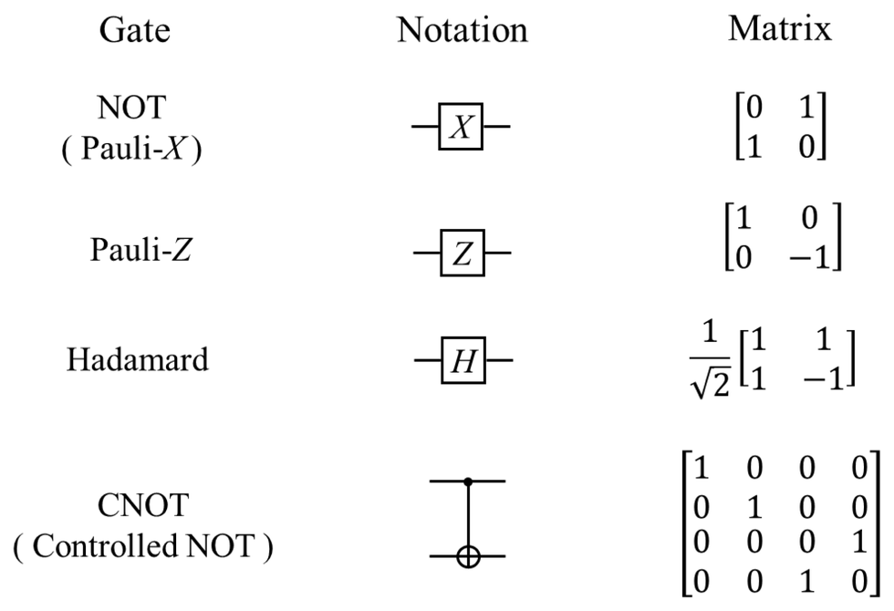
2. Quantum Gates and Measurement:
This layer consists of operations that manipulate qubits through quantum gates (similar to logical gates in classical circuits but operating under quantum rules) and the measurement processes which determine the state of qubits. Measurement collapses a qubit's state from a superposition to a definite state,

Slide 7
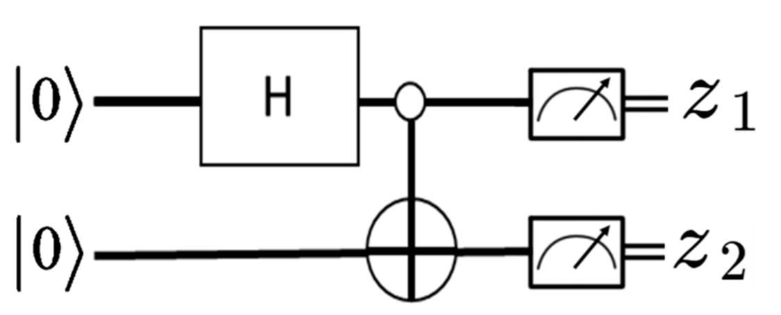
3. Quantum Circuits:
Quantum circuits are networks of quantum gates designed to perform specific algorithms. They organize the operations on qubits in a coherent sequence to execute computational tasks. This layer dictates how qubits interact and are manipulated during computation.

Slide 8
4. Quantum Algorithms and Protocols:
This layer involves the specific algorithms that are run on quantum computers, utilizing the properties of quantum mechanics to solve problems more efficiently than classical algorithms in some cases. These algorithms are designed to leverage entanglement, superposition, and interference to perform tasks like integer factorization (Shor's algorithm) or database searching (Grover's algorithm).

Slide 9
4. Quantum Algorithms and Protocols:
This layer involves the specific algorithms that are run on quantum computers, utilizing the properties of quantum mechanics to solve problems more efficiently than classical algorithms in some cases.
Quantum Algorithms:
Shor’s Algorithms
Grover Algorithms
Variational quantum eigensolver
Quantum protocols:
Quantum Teleportation
Super dense coding
Quantum key distribution

Slide 10
5. Applications:
The top layer represents the various applications that quantum computing can potentially revolutionize. This includes complex problem solving in fields like cryptography, material science, pharmaceuticals, and more, where quantum algorithms offer significant advantages.

Slide 11
Applications of quantum computing
Cryptography:
Quantum Key Distribution (QKD): Quantum computing can be used to create incredibly secure communication systems through quantum key distribution, which uses the quantum properties of particles to encrypt and transmit data in a way that is virtually immune to interception.
Breaking Encryption: On the flip side, quantum computers could potentially break many of the cryptographic systems currently in use. For example, Shor's algorithm could be used to factor large integers efficiently, undermining RSA encryption.
2. Drug Discovery and Materials Science:
Quantum computers can model molecular structures and complex chemical reactions with high accuracy. This capability could revolutionize the pharmaceutical industry by speeding up the drug discovery process, reducing costs, and allowing more personalized medicine approaches.
Similarly, they can help in the design of new materials with desired properties, which could impact various industries such as manufacturing, semiconductors, and new energy solutions.
3. Machine Learning and Artificial Intelligence:
Quantum algorithms have the potential to speed up data processing and improve the performance of machine learning models through faster matrix arithmetic and optimization routines. Quantum machine learning could handle tasks like classification, clustering, and feature detection.

Slide 12
Applications of quantum computing
4. Financial Modeling:
Quantum computing can optimize financial decision-making and risk analysis. It can simulate financial data and economic scenarios more efficiently, providing better insights into areas such as investment risk, portfolio optimization, and pricing of derivatives.
5. Climate and Environmental Modeling:
Quantum computers could dramatically improve the precision and speed of simulations used in climate science, helping to model complex environmental systems that involve interactions between numerous variables. This could enhance our understanding of climate change impacts and help in developing more effective mitigation strategies.
6. Quantum Simulation:
One of the original motivations for quantum computing was to simulate other quantum systems. Quantum computers could simulate physical phenomena that are difficult or impossible for classical computers to handle, leading to advancements in physics, chemistry, and materials science.
7. Traffic Optimization:
In urban planning and management, quantum computers could optimize traffic flow in real-time far more effectively than classical systems, potentially reducing congestion and improving energy efficiency.

